Slide 1









TITLE: “ Habit Loop Mirror “AI-based habit awareness system
TEAM NAME: Team Vizers
TEAM ID: HL140
DOMAIN: Artificial Intelligence and Data Science
TEAM LEADER NAME: Sri Vignesh R
MEMBER-1 NAME: Ramanarajarajan T
MEMBER-2 NAME: Sharvesh S

Slide 2


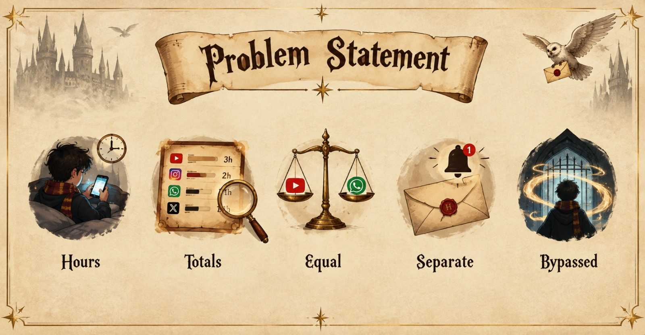
PROBLEM STATEMENT
People spend a lot of time on digital devices but often don't understand their own usage patterns and habits.
Gaps in current tools ( For Example :Screen Time, Digital Wellbeing ):
They show totals, not meaning.
They treat all screen time as equal.
Notification counts are shown separately from what you actually opened afterwards.
They push generic limits that people bypass.
Guilt-driven design makes users quit.
Research Articles :
1. https://www.sciencedirect.com/science/article/pii/S2666915323001816?via%3Dihub
2. https://pmc.ncbi.nlm.nih.gov/articles/PMC12718660/

Slide 3
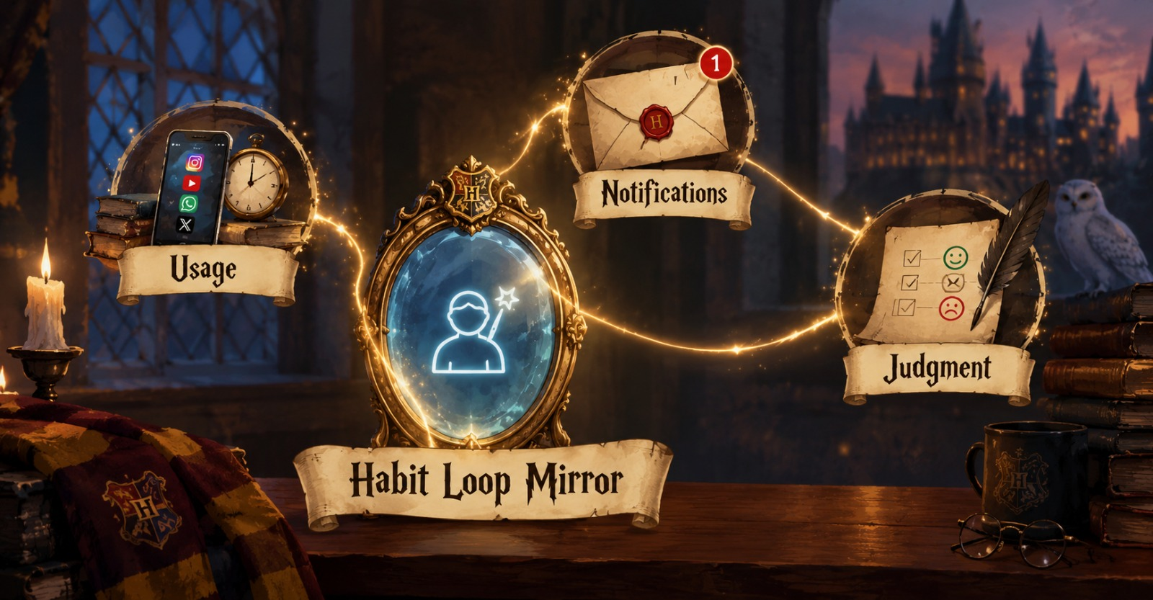
PROPOSED SOLUTION
Habit Loop Mirror is an AI-based habit awareness system. It answers "why did I use it, and was it worth it?" instead of only "how much?".
It links three things that other tools keep apart: usage, notifications, and the user's own judgment. Every insight is explainable and comes with evidence, and every goal is built from the user's own baseline.

Slide 4
OBJECTIVE
Analyze usage patterns → give personalized insights → help users set and track goals
Existing systems | Habit Loop Mirror
Totals only | Observation → Evidence → Why it matters → Try this
Notifications separate from usage | Trigger attribution: reactive vs self-initiated sessions, plus notification-to-open rate per app
"Social = bad" for everyone | Worth-it check: the user's own taps decide which apps are leaky
Guilt-driven resets | Forgiving streaks: one slip per 7 days is allowed
Same rules for everyone | Goal lenses: Sleep better, Study/work focus, Be present

Slide 5
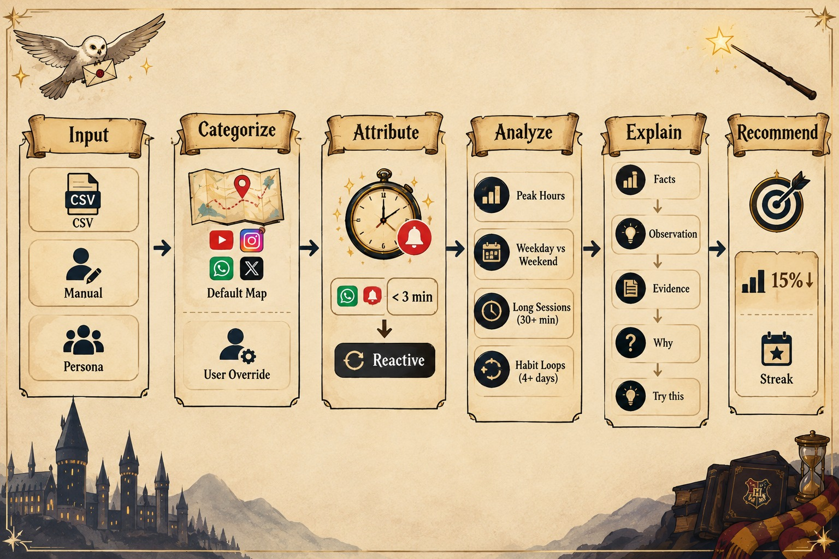
METHODOLOGY
Input: Sessions and notifications via CSV, manual entry, or synthetic personas
Categorize: Default app map, with user override
Attribute: A session within 3 min of a same-app notification is reactive
Analyze: Peak hours, weekday vs weekend, long sessions (30+ min), habit loops (same app and hour, 4+ days a week)
Explain: Facts computed with pandas → Observation → Evidence → Why → LLM
Recommend: Targets 15% below the user's own median, with a forgiving streak

Slide 6
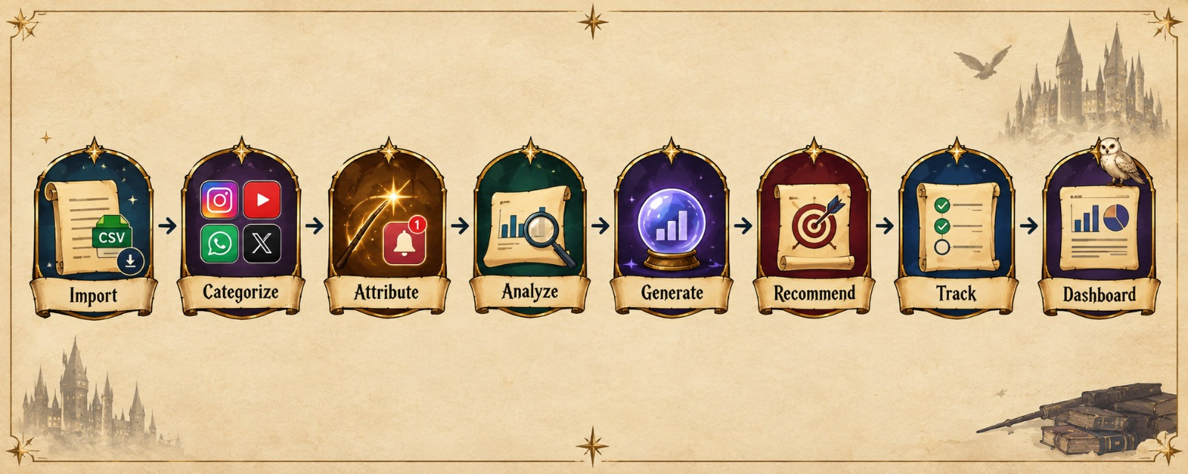
WORKFLOW
Import data → Categorize apps → Attribute triggers → Analyze patterns → Generate insights → Recommend goals → Track progress → Dashboard & report

Slide 7
SYSTEM ARCHITECTURE
Layer | Components
Input | CSV upload · Manual entry · Synthetic personas
Processing | Cleaning · Categorization · Trigger attribution
Analytics | Patterns · Notification stats · Habit detection
Insight | Rules + statistics → LLM rewording (template fallback)
Decision | Recommendations · Goals · Streaks
Presentation | Web Application using React and Python

Slide 8
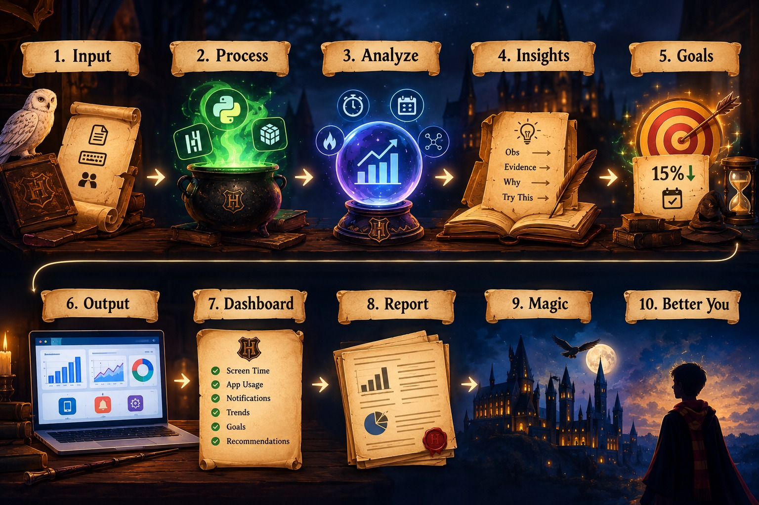
IMPLEMENTATION
Tech stack: Python,React,CSS,Node.js,FastAPI,pandas and NumPy,Plotly,SHAP(xAI),LLM API (Kimi K3)
How it works!
Input: CSV upload, manual entry, or synthetic personas
Trigger attribution: a session within 3 min of a same-app notification is labelled
Reactive Analytics: peak hours, weekly trends, notification heatmap, habit loops, long sessions
Insights: Observation → Evidence → Why → Try this, with numbers computed by code and the LLM only rewording
Goals: targets 15% below the user's own median, with forgiving streaks
Output: Dashboard & Report: Show screen time, app usage, notifications, trends, goals, and recommendations.

Slide 9
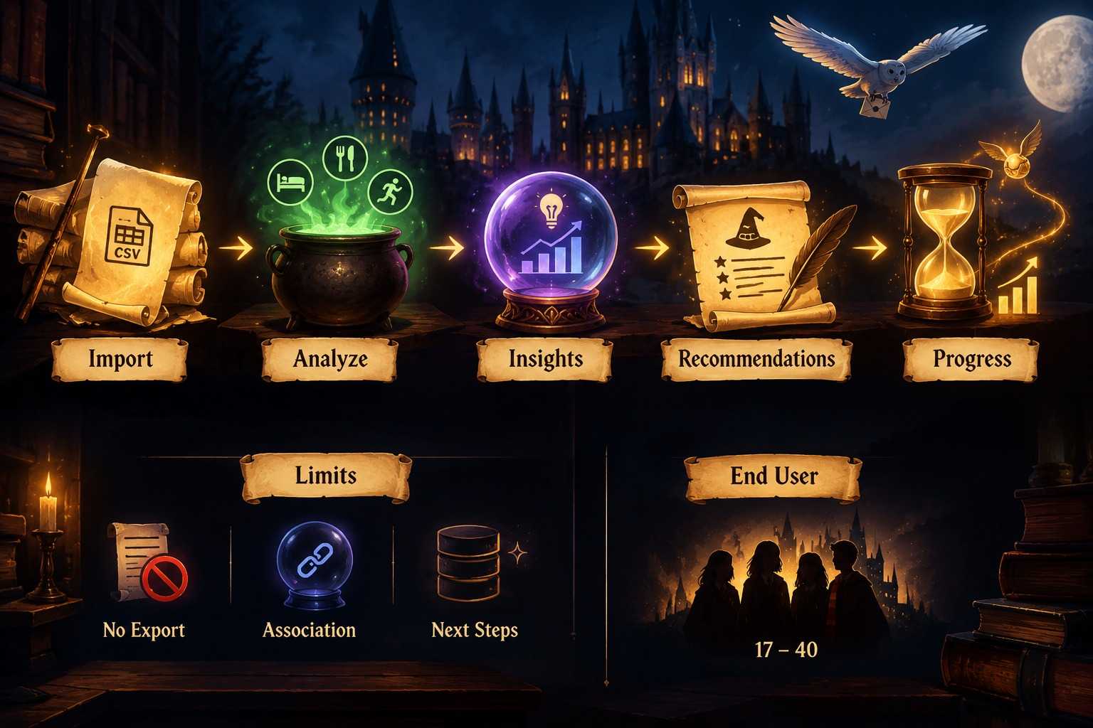
IMPLEMENTATION
Limitations :
Data comes from CSV, manual entry, or synthetic personas because phones offer no easy export
Trigger attribution shows association, not proof of cause
Next Phase : SQLite storage, screenshot import, Android collector
Demo: Import data → Analyze habits → Insights → Recommendations → Goal progress
Limitations and future work
End User : People around the age of 17 – 40

Slide 10


